Slide 1
Coloring
Mr Mack 2021

Slide 2
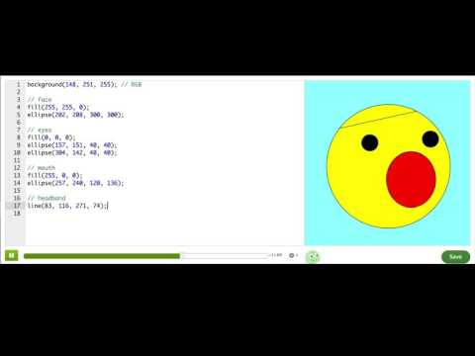
Coloring with code

Slide 3
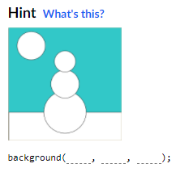
Practice: Sunny snowy day
We've drawn a snowman on a sunny day, and you'll add color to this drawing so that the snowman knows how sunny it really is!
Start off by using the background() command to change the color of the sky (Blue might be a nice color to use).
Color the sky!

Slide 4
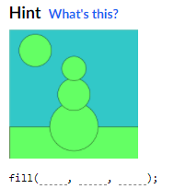
Practice: Sunny snowy day
Use the fill() command to change the color of the ground (Green might be a nice color to use).
Remember that, you'll need the fill() command to come before the rect() command that draws the ground. Don't worry if the color of the other shapes changes too, you'll fix them later!
Color the ground!

Slide 5
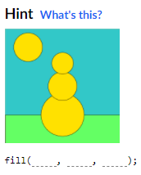
Practice: Sunny snowy day
Now, add another fill() command to change the color of the sun (Orange or yellow might be nice colors to use). Don't worry if the color of the snowman changes too, you'll fix him next!
Color the sun!

Slide 6
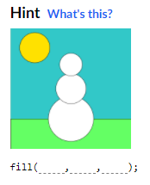
Practice: Sunny snowy day
Now, add another fill() command to change the color of the snowman (White might be a nice color to use). All three parts of the snowman's body should be one color, not three different colors, so you only need to add one fill() command for this step.
What about the snowman!?

Slide 7
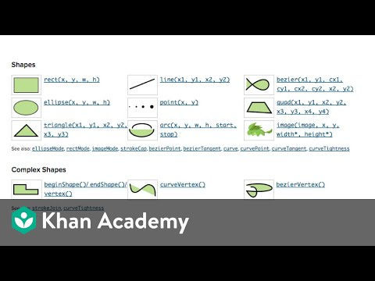
The Power of the Docs - https://p5js.org/reference/

Slide 8
Challenge: What's for dinner?
Now that you've learned how to draw and color shapes, use your skills to make something fun: dinner!
The program below only includes a simple plate, it's up to you to put dinner on the plate. Use shapes like rect(), ellipse(), and triangle() to draw food on the plate. Use fill() and stroke() to color them. Don't remember how to use something? Check the "Documentation" tab and click for examples.
After you're done, show it to your friends and family. You can even offer to cook it for them tomorrow. :-)
Don't want to make dinner? Draw some other meal instead.

